Slide 1

TORNJAK ARCHITECTURE WITH IAM

Slide 2

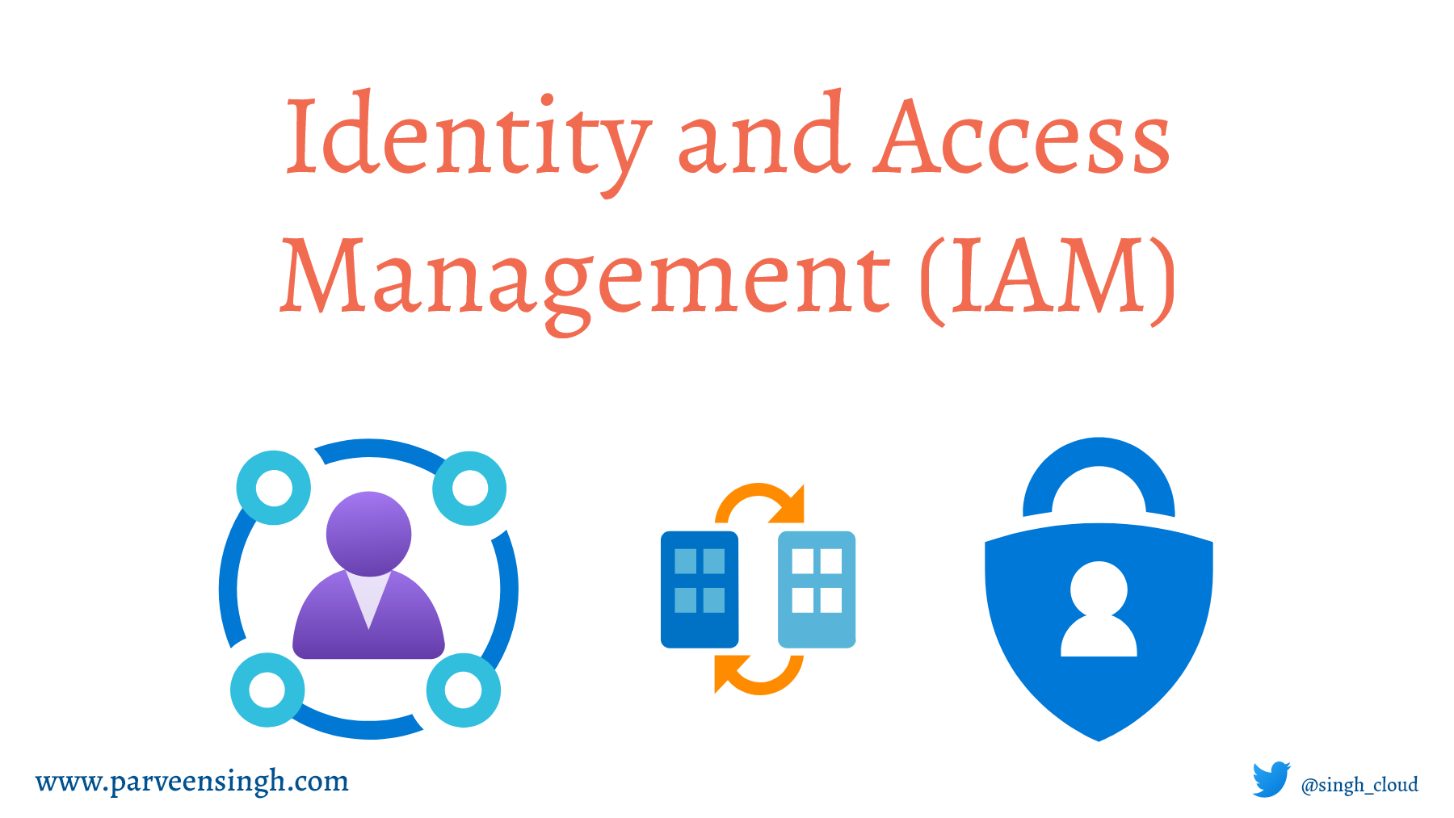


TORNJAK SERVER ARCHITECTURE
User
TORNJAK SERVER
Credentials
Tornjak Server FE
Access Token
API Calls
+
Access Token
IAM Server
(Oauth 2.0)
Tornjak Server DB
Tornjak Server BE
Exposes JWKS
URL for token
verification
HostPath/ Socket
SPIRE Server
Cluster 1
Cluster 2
SPIRE Agent A
SPIRE Agent B

Slide 3
TORNJAK MANAGER ARCHITECTURE
TORNJAK MANAGER
IAM Server
(Oauth 2.0)
Tornjak Manager FE
Upload Offline Token
Manager/
Operator
API Calls
Offline Token
Send Offline Token File
Send Offline Token File
Tornjak Manager BE
Offline Token 1
Offline Token 2
Manager DB
API Calls + Offline Token 1
API Calls + Offline Token 2
SERVER 1
SERVER 2
Tornjak Server FE
Credentials
Tornjak Server FE
Credentials
Tornjak Server DB
API Calls
+
Access Token
Access Token
&
Offline Token
(If provided in scope)
Tornjak Server DB
API Calls
+
Access Token
Access Token
&
Offline Token
(If provided in scope)
IAM Server
(Oauth 2.0)
IAM Server
(Oauth 2.0)
Tornjak Server BE
Exposes JWKS
URL for token
verification
Tornjak Server BE
Use Offline Token
to Exchange With
an Access Token
Exposes JWKS
URL for token
verification
Use Offline Token
to Exchange With
an Access Token
/
/
SPIRE Server
SPIRE Server
Cluster 2
Export Offline Token to Local Machine
Cluster 2
Export Offline Token to Local Machine
Cluster 1
Cluster 1
SPIRE Agent A
SPIRE Agent B
SPIRE Agent A
SPIRE Agent B

